Slide 1
Storytelling & Visualization:
Construction Spending Analysis
Jessie Gong

Slide 2
Introduction
Questions:
Findings & Recommendations:
Data Analysis:

Slide 3
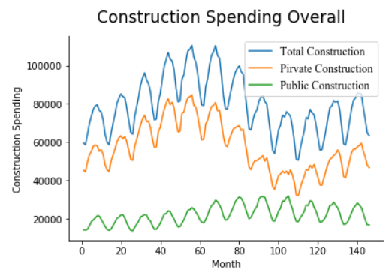
Detailed Analysis
Description

Slide 4
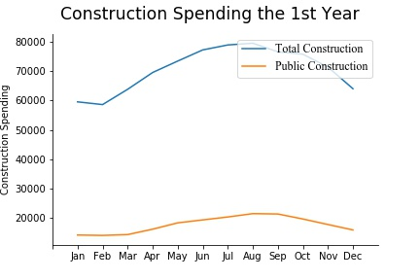
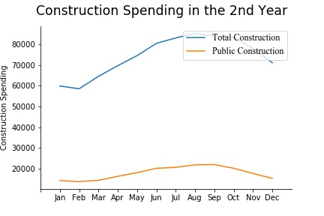
Detailed Analysis

Slide 5
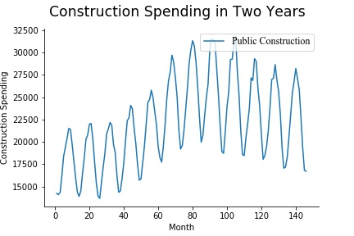
Detailed Analysis
More premium subscribers

Slide 6
Summary & Recommendations
CEO
Factors that influence the trend
Recommendations

Slide 7
Conclusion

Slide 8
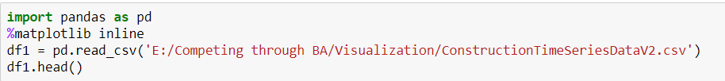
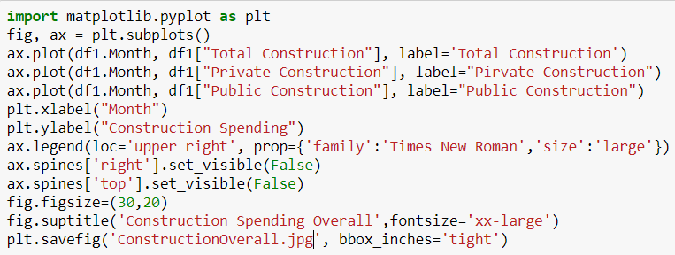
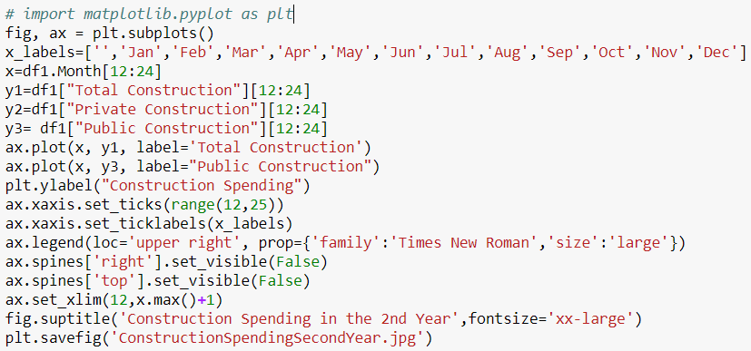
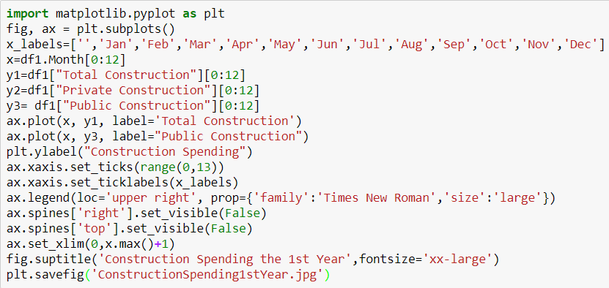
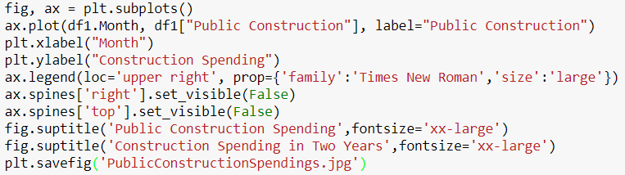
Backup: Python code for graphs
CEO

